Slide 1
Introduction to Java
Object Oriented Programming
with Java
Chapter 1
FPTU Da Nang – IT Department

Slide 2
Objectives - Content
Ice-breaking
Java brief history
Features of Java language
Java Virtual Machine
Types of Java Programs
System Security Model of Java
Installation
<number> of 30

Slide 3
Ice-breaking
Who am I?
Who are you?
  What IT means to you?
  Your expectation?
Course Contents
Timetable
Resource
<number> of 30

Slide 4
Java brief history
Java was developed by Sun Microsystems in June 1995.
1990, Oak, James Gosling alpha version May 23, 1995, version 1.2 - also known as Java 2.0 - released December 1998
Java is built from C and C++.
Inheriting C syntax and object-oriented ideas of C++.
Name of a technology line - J2EE
Java was acquired by Oracle from Sun in 2009
<number> of 30

Slide 5
Features of Java
Java: programming language – technology
Outstanding Features
  Simple
  Platform independent
  Object Oriented
  Portability
  Distributed
Translated
Interpreted
Multi-threaded
Robust
Safe
<number> of 30

Slide 6
Features of Java
  Simplicity:
  + Familiar to C programmers
  + Eliminates complex and confusing features of C++ such as operator overloading, pointer manipulation, multiple inheritance
  Platform independent:
  + Java is designed to support network applications running on Java Virtual Machines
  + Write once, run anywhere
  Object Oriented :
  + Encapsulation
  + Polymorphism
  + Inheritant
  + Dynamic binding
  + All are objects
<number> of 30

Slide 7
Features of Java
  Distributed:
    Java has an extension library for distributed programming: (net, rmi, idl, CORBA)
    Java applications can access Internet objects using the same URL as file access local
  Robust
    Java has strict checking mechanism, eliminates read and write errors or corrupt data
    Efficient memory management model, automatically reclaims memory using Gabagge Collection
<number> of 30

Slide 8
Features of Java
  Secure :
    Java provides a strictly tested execution environment - Never assumes executable code is secure
    Multi-tier system security check mechanism
  Portability:
    the ability to deploy Java applications on a variety of platforms
    Java compiler generates an architecture-neutral object file format, which makes the compiled code executable on many processors, with the presence of Java runtime system
<number> of 30

Slide 9
Features of Java
Compiled–Interpreted :
  Java source code is compiled into ByteCode before being run on the Java virtual machine by the interpreter
  The Virtual Machine (Java interpreter) provides a set of standardized functions & functions for all environments
Multi-thread:
  can perform many tasks simultaneously, allows the developers to construct interactive applications that can run smoothly
  C/C++ application : single-threaded
<number> of 30

Slide 10
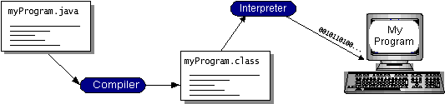
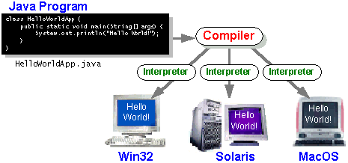
Features of Java
<number> of 30

Slide 11
Java platform
The Java Platform
  Platform is the hardware & software environment where program run
  Java platform differed from other environments as it is software- based (software-only platform) running on the diversity of hardware
The Java platform has two components:
  Java Virtual Machine ( Java Virtual Machine - Java VM):
  All Java interpreters – whether a development tool or a Web browser that can run an applet are executable versions of a JVM
  Java Application Programming Interface (Java API) is a collection of libraries of related classes and programming interfaces organized into packages
<number> of 30

Slide 12
Java Virtual Machine
JVM (Java Virtual Machine) is the heart of Java language
5 components of the Java environment.
  Java language
  Bytecode
  Sun's Java Class Library
  Java Virtual Machine
  Structure of the .class . file
<number> of 30

Slide 13
Java Virtual Machine
Virtual machine is actually a software concept based on the idea of ​​a virtual computer with a set of instructions to perform tasks.
The JVM creates the program code execution environment with the following tasks:
  load class file
  memory management
  perform memory recall functions
<number> of 30

Slide 14
Java Virtual Machine
Garbage Collection - Memory Management
  Java Virtual Machine uses 2 separate heap areas to manage static and dynamic memory allocation.
  A heap is a statically allocated memory area used to load bytecode, constants, and class methods.
  The second heap splits into two parts that can expand in opposite directions when needed. One part is used to store instance variables of objects, the other part to store variables that refer to objects.
<number> of 30

Slide 15
Java Virtual Machine
Check Class File
  Applies to all classes loaded at runtime for system security
  The Class Loader is responsible for checking all unorthodox classes to make sure they follow the correct formats.
  The .class file consists of 3 logical parts:
    Compiled byte codes
    Information about the class such as methods, properties, constants, interfaces.
    This information is organized independently into tables
<number> of 30

Slide 16
Java Virtual Machine
The inspection of classes takes place at 4 levels.
  check format of .class file
  check for semantic consistency of .class files
  check method bytecode independently
  check at runtime on the Java JVM
<number> of 30

Slide 17
Types of Java Programs
Applets
  Java program that embed and runs on a web page
  Applets are Java codes that are compiled and stored on the Web Server and referenced by the website using special HTML codes.
  An applet is a subclass of the Applet class contained in the java.applet package with 23 methods
  Ex: Instantly plotted graphs with real-time data
<number> of 30

Slide 18
Example of 1 Applet
Using the editor to write the code
import java.applet.*;
import java.awt.*;
/* The HelloWorld class implements an applet that * simply displays "Hello World!". */
public class HelloWorld extends Applet {
public void paint(Graphics g) {
g.drawString("Hello world!", 50, 25);
}
}
Save this code as HelloWorld.java
<number> of 30

Slide 19
Applet demo..
Create HTML page that embed applet
<HTML>
<HEAD>
<TITLE>A Simple Program</TITLE>
</HEAD>
<BODY> Here is the output of my program:
<APPLET CODE="HelloWorld.class" WIDTH=150 HEIGHT=25>
</APPLET>
</BODY>
</HTML>
Save the file: Hello.html.
<number> of 30

Slide 20
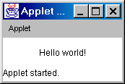
Applet demo
Compile java source file to the bytecode
C:\>javac HelloWorld.java
The compiler with create the bytecode as file HelloWorld.class
View the applet HelloWorld using appletviewer
C:\>appletviewer Hello.html
<number> of 30

Slide 21
Types of Java Programs..
Applications
  Application is a program that runs from a command window without the need for a browser like an applet.
  All applications need to have main() method as the first method to be called.
  The application interface is diversity while an applet is always displayed graphically.
  Applications are not subject to the same restrictions as applets.
  Applications are trusted by default and allow unrestricted access to system resources.
<number> of 30

Slide 22
Example of Java Application
Write Java source file
class HelloWorldApp{
public static void main(String[] args) {
System.out.println("Hello World!");
}
}
Save the file as HelloWorldApp.java
file name must match the class name
<number> of 30

Slide 23
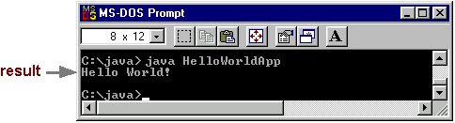
Example of Java Application
Compile the bytecode
D:\JDK\Bin> javac HelloWorldApp.java
Run the application
D:\JDK\Bin> java HelloWorldApp
<number> of 30

Slide 24
Type of Java programs..
Servlets
  A program that runs on a server to provide services.
  Servers can be Web Servers, Mail Servers, File Servers, Database Servers...
  Java Server Toolkit, Servlet API are tools and libraries that support web programming with Java
<number> of 30

Slide 25
Types of Java Programs..
Servlets
  The servlet helps the server handle the requests coming from the client side.
  are widely used to replace the role of CGI scripts.
  Servlets are for servers like applets are for browsers.
  servlets do not have a graphical interface like applets.
  widely used on HTTP servers
<number> of 30

Slide 26
Types of Java Programs..
Java Beans
  JavaBeans are COM (components object model) of Java technology
  Create shared components for applications.
  customizable at design time.
  Beans can interact with each other.
Distributed Objects
  support the development of client-server distributed applications
  An application on one JVM that invokes method on another JVM.
  RMI: Remote method invocation.
  Enterprise JavaBean
<number> of 30

Slide 27
Install developer tools
Install JDK 8.x
  javac.exe : compiler, translate source code into bytecode
    javac Hello.java
  java.exe : interpreter, run application
    java Hello
Install IDE : NetBean 8.x
Java Class Library Documentation
  Java documentation
  https://docs.oracle.com/javase/8/docs/
First application with Java and Netbean
<number> of 30

Slide 28
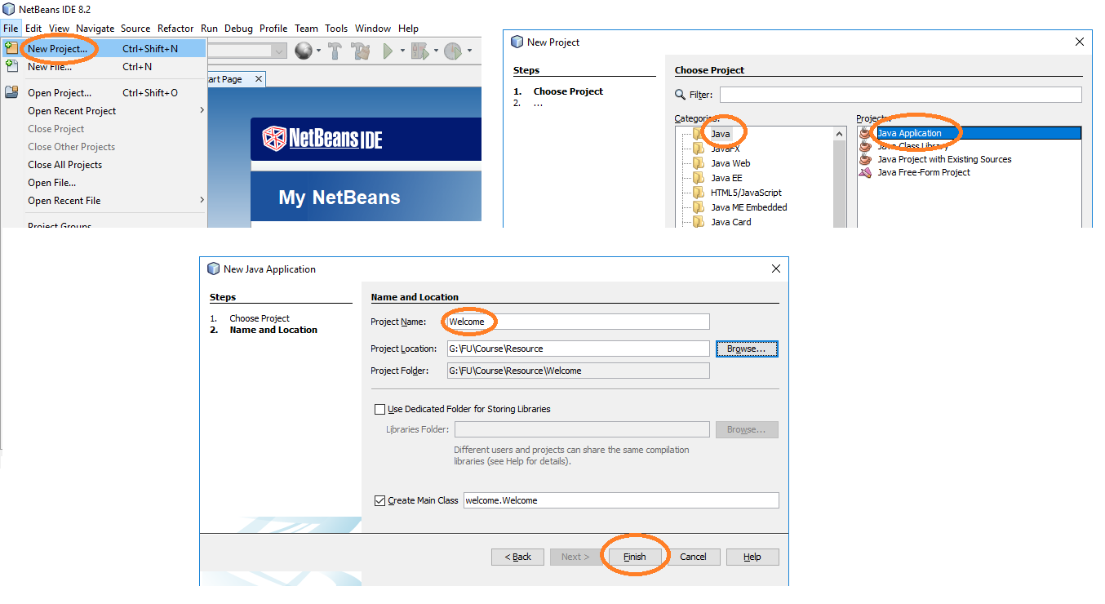
First App. on Netbean
<number> of 30

Slide 29
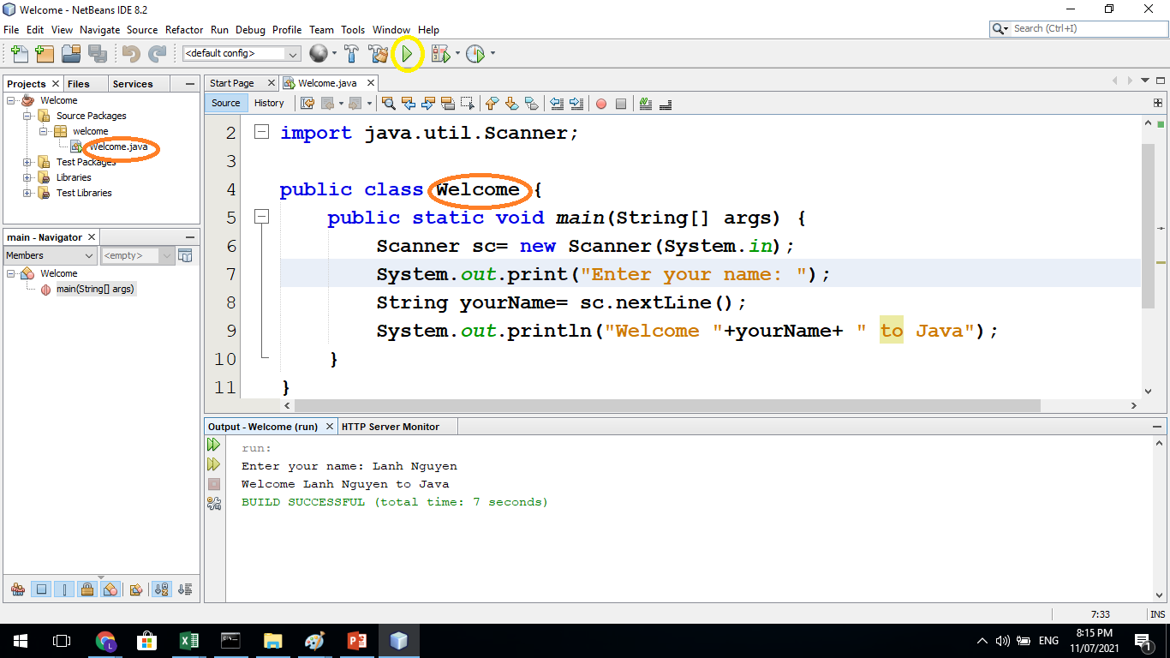
First App. on Netbean
<number> of 30

Slide 30
Constructive Questions..
Compare C and Java Programming Languages
Why the JDK installed for different operating systems is differ from each others? Does this conflict with Java's platform independent characteristic?
Why we need to learn many programming languages?
What is the difference of JDK and NetBean? Besides Netbean, what other tools can be used?
Write a program to add, subtract, multiply and divide 2 integers
Write a welcome.. program that receives yourName through the argument of main method
<number> of 30

